Slide 1
Digital Portfolio
STUDENT NAME: N. JAYASURIYA
REGISTER NO AND NMID: 2428c0090 CDE8DA009250E76A6CE4EBC1FBBDD006
DEPARTMENT: BSC AI AND ML
COLLEGE: COLLEGE/ UNIVERSITY SRI KRISHNA ADITHYA COLLEGE OF ART’S AND SCIENCE / BHARATHIYAR UNIVERSITY

Slide 2
PROJECT TITLE Interactive Digital Portfolio Website”

Slide 3


AGENDA
Problem Statement
Project Overview
End Users
Tools and Technologies
Portfolio design and Layout
Features and Functionality
Results and Screenshots
Conclusion
Github Link
3/21/2024 Annual Review

Slide 4

PROBLEM STATEMENT
Every project begins with a problem or challenge that needs a solution. This section explains what issue is being addressed, why it is important, and the negative impacts if the problem is left unsolved. Clearly defining the problem sets the foundation for the entire project.

Slide 5

PROJECT OVERVIEW
This section provides a summary of the project, including its objectives, purpose, and overall approach. It highlights what the project aims to achieve and how it plans to deliver a meaningful solution to the identified problem.

Slide 6

WHO ARE THE END USERS?
End users are the people or groups who will directly benefit from this project. They are the target audience who will use or interact with the final product. Identifying end users ensures that the project is designed with their needs, preferences, and challenges in mind

Slide 7

TOOLS AND TECHNIQUES
This part lists the software, programming languages, frameworks, or platforms that will be used to develop the project. It ensures that the chosen technologies are efficient, reliable, and suitable for solving the defined problem.

Slide 8
POTFOLIO DESIGN AND LAYOUT
This section focuses on the design aspects of the portfolio, including structure, visual elements, and layout. A well-organized design improves readability, navigation, and overall user experience.
8

Slide 9
FEATURES AND FUNCTIONALITY
Here, the key features and functionalities of the portfolio are explained. This includes interactive elements, navigation menus, project showcases, and other features that make the portfolio dynamic and engaging

Slide 10
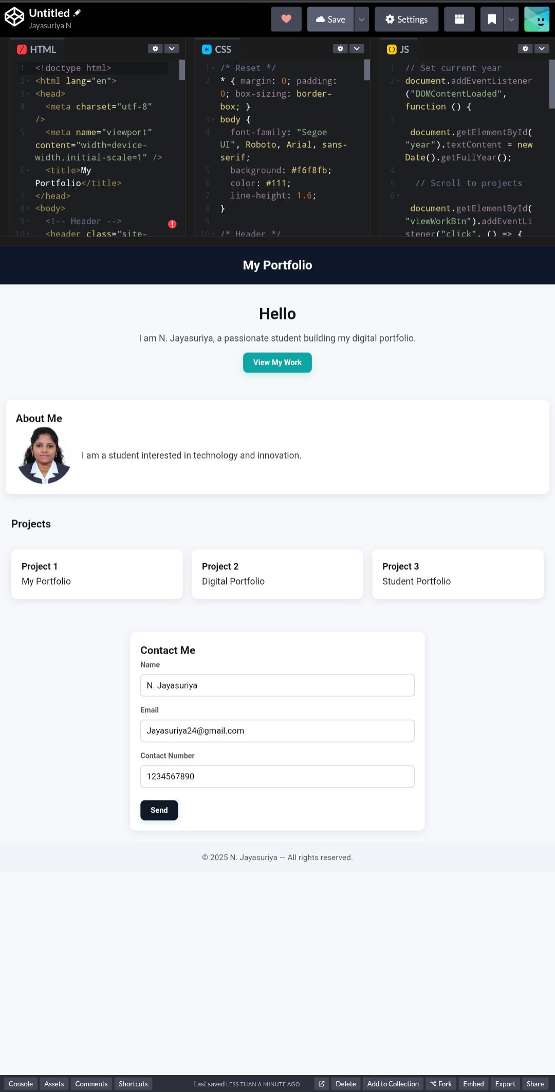

RESULTS AND SCREENSHOTS
This section provides the outcomes of the project along with visual evidence in the form of screenshots. Screenshots help in demonstrating the working of the system, design quality, and user interface.
3/21/2024 Annual Review
10

Slide 11
CONCLUSION
The conclusion summarizes the project’s overall contribution. It highlights the achievements, lessons learned, and the value delivered through the portfolio. It also sets the stage for possible improvements in the future.
11

Slide 12
GitHub Link
https://github.com/njayasuriyamanjula242006-sys/Jayasuriya.git

